Slide 1


ISC 2019 Birds-of-a-Feather
Integration of AI & HPC 18.06.2019 | Dr Atanas Atanasov, Michael Steyer, Dr Sofia Vallecorsa, Dr. David Brayford

Slide 2
Intel Optimized Tensorflow
Atanas Atansov, Fabio Baruffa, Walter Riviera, Micheal Steyer

Slide 3
Speed up development
using open AI software
Machine learning
Deep learning
TOOLKITS
App developers
 | Intel® Distribution of OpenVINO™ Toolkit¹ | Nauta (Beta)
 | Deep learning inference deployment on CPU/GPU/FPGA/VPU for Caffe*, TensorFlow*, MXNet*, ONNX*, Kaldi* | Open source, scalable, and extensible distributed deep learning platform built on Kubernetes
libraries
Data scientists
Python | R | Distributed
Scikit-learn Pandas NumPy | Cart RandomForest e1071 | MlLib (on Spark) Mahout
Intel-optimized Frameworks
 | And more framework optimizations underway including PaddlePaddle*, CNTK* & others
*
*
*
*
*
Kernels
Library developers
Intel® Distribution for Python* | Intel® DAAL
Intel distribution optimized for machine learning | Intel® Data Analytics Acceleration Library (incl machine learning)
Intel® Math Kernel Library for Deep Neural Networks (Intel® MKL-DNN)
Open source DNN functions for CPU / integrated graphics
Intel® nGraph™ Compiler (Beta)
Open source compiler for deep learning model computations optimized for multiple devices (CPU, GPU, NNP) from multiple frameworks (TF, MXNet, ONNX)
Visit: www.intel.ai/technology
¹ An open source version is available at: 01.org/openvinotoolkit *Other names and brands may be claimed as the property of others.
Developer personas show above represent the primary user base for each row, but are not mutually-exclusive
All products, computer systems, dates, and figures are preliminary based on current expectations, and are subject to change without notice.
Optimization Notice
Notes:
With Intel AI, you can speed up development using open AI software.
Intel is investing in AI tools that get the most out of, and streamline development across, each hardware option in our portfolio. This ultimately accelerates total time-to-solution.
For application developers—those who deploy solutions using AI-based algorithms—Intel has several tools to optimize performance and accelerate time-to-solution. For deep learning, the Intel Distribution of OpenVINO Toolkit facilitates model deployment for inference by converting and optimizing trained models for whichever hardware target is downstream. It offers support for models trained in TensorFlow, Caffe, and MXNet on CPU, integrated GPU, VPU (Movidius Myriad 2/Neural Compute Stick), and FPGA. Intel also launched the beta of a tool to help compress the end-to-end deep learning development cycle. This open source, scalable and extensible distributed deep learning platform, built on Kubernetes, is called Nauta (pronounced as ‘nau‧ta’; means ‘sailor’ in Latin), formerly know as the Intel Deep Learning Studio.
For data scientists—those who create AI-based algorithms—Intel contributes to and optimizes a set of open source libraries that are widely used for machine and deep learning. There are a number of such machine learning libraries that can be used to get the most out of Intel hardware today, spanning Python, R, and Distributed. For deep learning, Intel aims to ensure that all the major deep learning frameworks and topologies run well on Intel hardware, and customers are of course free to choose whichever frameworks best suit their needs. We’ve been directly optimizing the most popular AI frameworks first, based on market demand, and producing huge improvements. Today, we have many optimized topologies available for TensorFlow, MXNet, Caffe2/PyTorch, and BigDL on Spark, and you can download and install the optimized version of these frameworks by clicking on the link in this slide. Going forward, we intend to enable even more frameworks like PaddlePaddle, CNTK & many more through the Intel nGraph compiler.
For library developers—those who develop and optimize APIs, libraries, and frameworks to support new algorithms and topologies on the underlying hardware—Intel offers a host of foundational building blocks to get the most out of our hardware. Beginning on the left with the primitives category, the Data Analytics Acceleration Library and Intel Python distribution are important building blocks for machine learning. The DNN (deep neural network) open source libraries contain CPU-optimized functions that are most relevant for, you guessed it, deep learning model development. On the right side of this row is a description of the Intel nGraph library (formerly the Nervana Graph), which takes the computational graph from each deep learning framework and creates an intermediate representation, which is executed by calling the math accelerator software libraries of each Intel hardware target. This compiler reduces the need for framework and model direct optimization for each hardware target using low-level software and math accelerator libraries. Today, it supports Intel Xeon CPUs, GPU (CUDA), and the Crest family, with more hardware targets planned going forward.

Slide 4
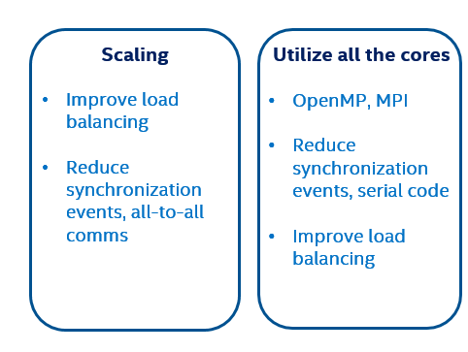
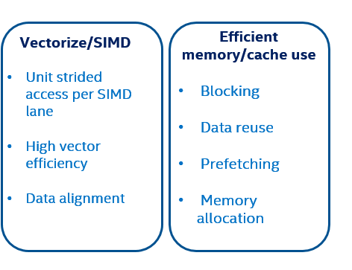

Deep learning Framework (optimizations by Intel)
=
See installation guides at ai.intel.com/framework-optimizations/
SEE ALSO: Machine Learning Libraries for Python (Scikit-learn, Pandas, NumPy), R (Cart, randomForest, e1071), Distributed (MlLib on Spark, Mahout)
*Limited availability today
Other names and brands may be claimed as the property of others.
Notes:
Here you can see some of the ways we have optimized the frameworks to make sure they:
Scale effectively with improved load balancing and reduced synchronization events
Use all the cores effectively
Use single instruction multiple data (SIMD) instructions to process multiple data items simultaneously. The Intel® Xeon® Scalable processor introduces Intel® AVX-512, with ultra-wide 512 bit vectors for processing data in parallel.
And, finally, we optimize to make sure the frameworks use memory efficiently.
Today, we’ve optimized numerous topologies across a wide range of DL usages for TensorFlow, MXNet, Caffe2/PyTorch and BigDL for Spark, with more frameworks under optimization (like PaddlePaddle, CNTK & more). To see the latest status and download installation guides, visit ai.intel.com/framework-optimizations.

Slide 5

How TO Get it?
Customize the install process and build your own optimized system
git clone https://github.com/tensorflow/tensorflow
>>./configure.sh
“Do you wish to build TensorFlow with XYZ support [y/N]”
Bazel
(java>8, gcc>4.5.0)
>>bazel build --config=mkl --copt=“-DEIGEN_USE_VML” …
>>bazel-bin/tensorflow/tools/pip_package/build_pip_package /tmp/tensorflow_pkg
TF Wheel
>>pip install --upgrade /tmp/tensorflow_pkg/<wheel name>
Notes:
Download source code from github:
git clone https://github.com/tensorflow/tensorflow
“./configure” for best performance on Intel Architecture:
Intel MKL-DNN will be automatically downloaded
For multi-node training (Omni-path):
“Do you wish to build TensorFlow with VERBS-RDMA support [y/N]”
Install OPA HFI verbs driver and libibverbs library (MCHAPICH2)
Turn on RDMA connection, add the protocol "grpc+verbs" in server definition:
on ps: server = tf.train.Server(cluster, job_name=“ps", task_index=0, protocol='grpc+verbs') # default protocol is 'grpc‘
on worker: server = tf.train.Server(cluster, job_name=“worker", task_index=0, protocol='grpc+verbs')
Build for best performance on CPU
bazel build --config=mkl --copt=“-DEIGEN_USE_VML” -c opt //tensorflow/tools/pip_package:build_pip_package
The bazel build command builds a script named build_pip_package. Running this script as follows will build a .whl file
$ bazel-bin/tensorflow/tools/pip_package/build_pip_package /tmp/tensorflow_pkg

Slide 6
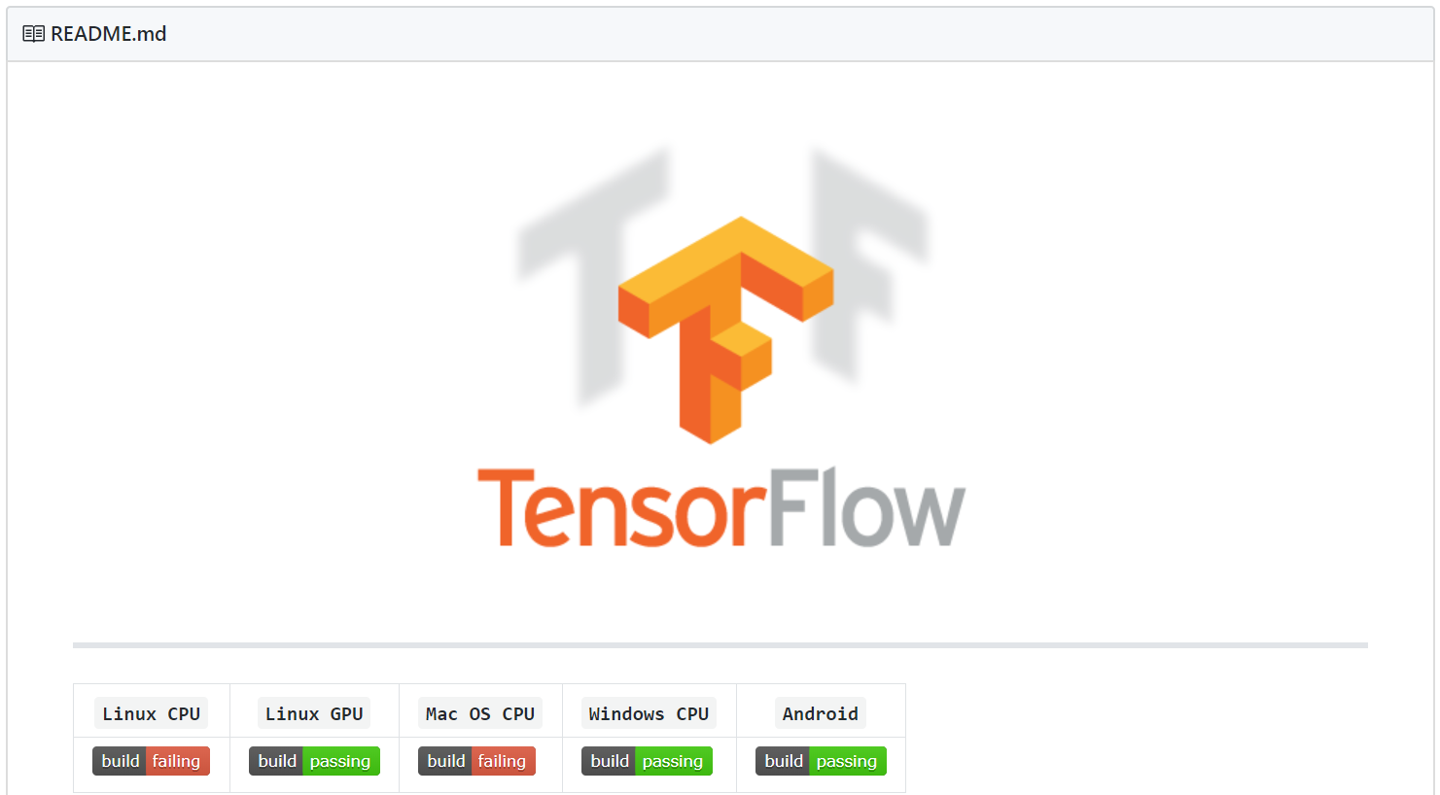
get a prepacked wheel
Use a pre-packed wheel
https://software.intel.com/en-us/articles/intel-optimized-tensorflow-wheel-now-available
$ conda install tensorflow-mkl
$ pip install intel-tensorflow

Slide 7
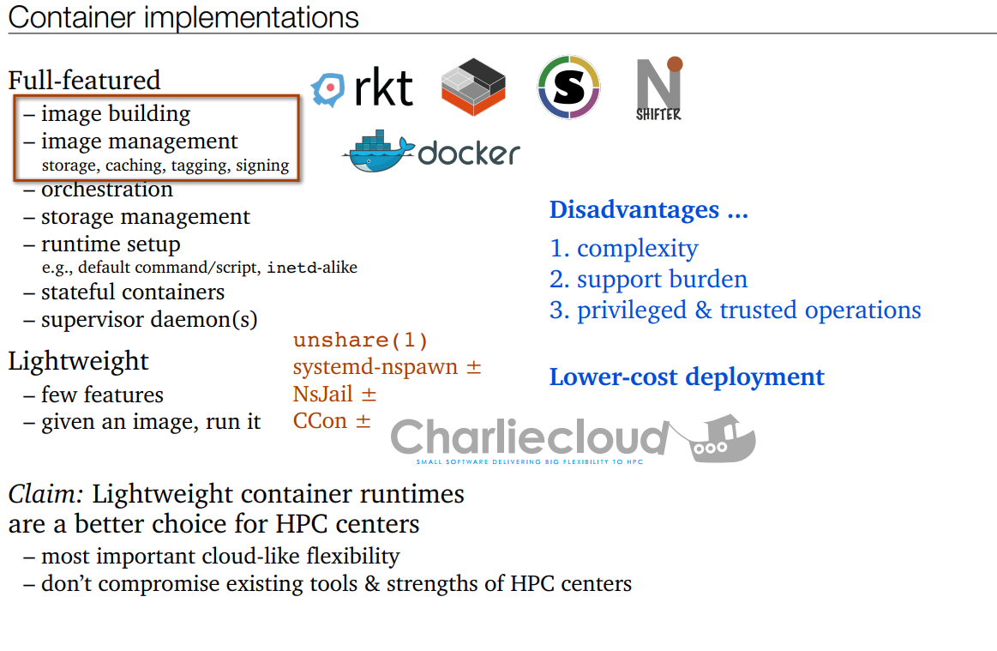

Slide 8
Relative Performance and Memory Usage
HPE BL460c Gen8
1S x E5-2670
128 MB RAM
Data sets and kernel sources on NFS

Slide 9
QUESTIONS (sli.do):
Do you need GPU for DL?
[yes, not necessarily]
What Data A. and std. ML have in common?
[ they both requires GPUs, nothing, they are not necessarily cumbersome wload ]
What Intel product would you use for deploying Vision sol.?
[Openvino, IDP, Intel tensorflow]
What Intel product would you use for Data analytics.?
[Openvino, IDP, Intel tensorflow]
What Intel product would you use to train/deploy a NN on a big cluster?
[Openvino, IDP, Intel tensorflow]
Notes:
20170609 update DNN Primitives
MKL covers a broad spectrum of mathematical domains, from sparse and dense linear algebra for both multicore and clusters, FFTs for multicore and clusters, vector math, vector RNGs, special routines for statistical analysis and more.

Slide 10
Legal Disclaimer & Optimization Notice
Intel technologies’ features and benefits depend on system configuration and may require enabled hardware, software or service activation. Learn more at intel.com, or from the OEM or retailer.
Performance results are based on testing as of May 29, 2019 and may not reflect all publicly available security updates. See configuration disclosure for details. No product can be absolutely secure.
Software and workloads used in performance tests may have been optimized for performance only on Intel microprocessors. Performance tests, such as SYSmark and MobileMark, are measured using specific computer systems, components, software, operations and functions. Any change to any of those factors may cause the results to vary. You should consult other information and performance tests to assist you in fully evaluating your contemplated purchases, including the performance of that product when combined with other products. For more complete information visit www.intel.com/benchmarks.
INFORMATION IN THIS DOCUMENT IS PROVIDED “AS IS”. NO LICENSE, EXPRESS OR IMPLIED, BY ESTOPPEL OR OTHERWISE, TO ANY INTELLECTUAL PROPERTY RIGHTS IS GRANTED BY THIS DOCUMENT. INTEL ASSUMES NO LIABILITY WHATSOEVER AND INTEL DISCLAIMS ANY EXPRESS OR IMPLIED WARRANTY, RELATING TO THIS INFORMATION INCLUDING LIABILITY OR WARRANTIES RELATING TO FITNESS FOR A PARTICULAR PURPOSE, MERCHANTABILITY, OR INFRINGEMENT OF ANY PATENT, COPYRIGHT OR OTHER INTELLECTUAL PROPERTY RIGHT.
Copyright © 2019, Intel Corporation. All rights reserved. Intel, the Intel logo, Pentium, Xeon, Core, VTune, OpenVINO, Cilk, are trademarks of Intel Corporation or its subsidiaries in the U.S. and other countries.
Optimization Notice
Intel’s compilers may or may not optimize to the same degree for non-Intel microprocessors for optimizations that are not unique to Intel microprocessors. These optimizations include SSE2, SSE3, and SSSE3 instruction sets and other optimizations. Intel does not guarantee the availability, functionality, or effectiveness of any optimization on microprocessors not manufactured by Intel. Microprocessor-dependent optimizations in this product are intended for use with Intel microprocessors. Certain optimizations not specific to Intel microarchitecture are reserved for Intel microprocessors. Please refer to the applicable product User and Reference Guides for more information regarding the specific instruction sets covered by this notice. Notice revision #20110804
10

Slide 11

HPC and AI convergence
An example from High Energy Physics
Sofia Vallecorsa
Frankfurt- 19/06/2019

Slide 12
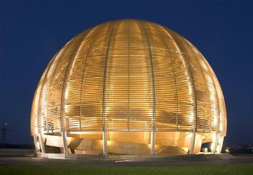
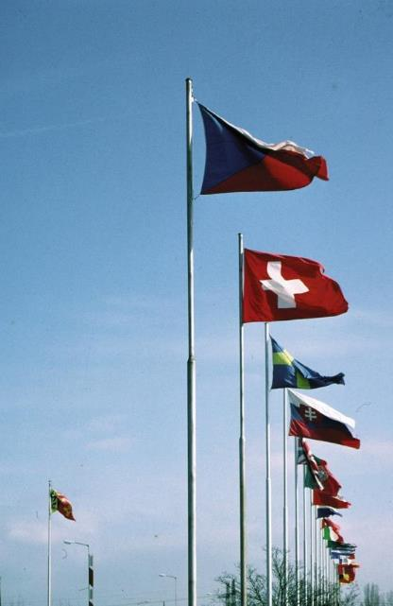
CERN
“Science for peace”
International organisation close to Geneva, straddling Swiss-French border, founded 1954
Facilities for fundamental research in particle physics
23 member states, 1.1 B CHF budget
3’197 staff, fellows, apprentices, …
13’128 associates
1954: 12 Member States
Members: Austria, Belgium, Bulgaria, Czech republic, Denmark, Finland, France, Germany, Greece, Hungary, Israel, Italy, Netherlands, Norway, Poland, Portugal, Slovak Republic, Spain, Serbia, Sweden, Switzerland, United Kingdom Candidate for membership: Cyprus, Slovenia
Associate members: India, Lithuania, Pakistan, Turkey, Ukraine
Observers: EC, Japan, JINR, Russia, UNESCO, United States of America
Numerous non-member states with collaboration agreements
2’531 staff members, 645 fellows, 21 apprentices
7’000 member states, 1’800 USA, 900 Russia, 270 Japan, …

Slide 13
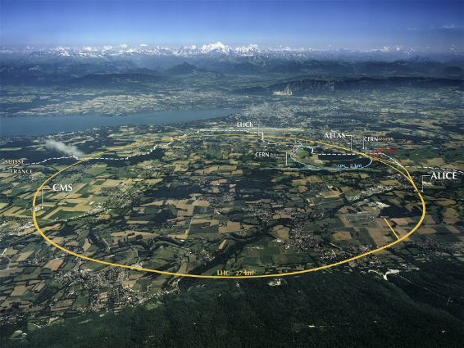
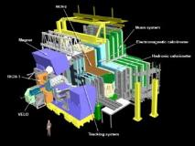
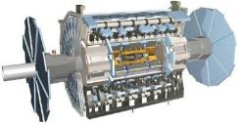
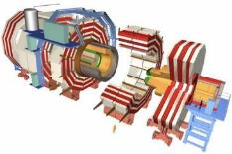
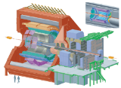
The Large Hadron Collider (LHC)

Slide 14
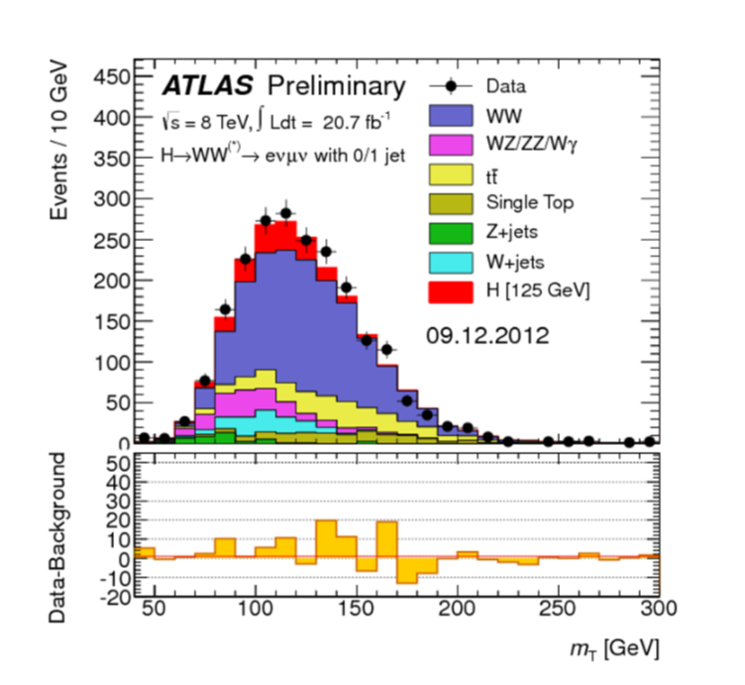
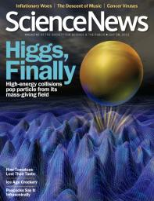
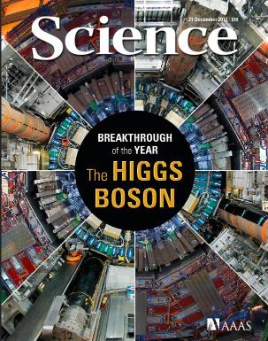
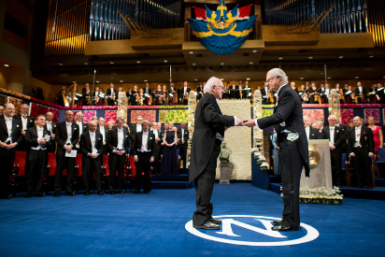
The Higgs Boson

Slide 15
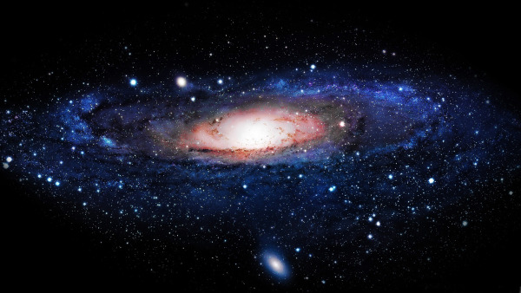
The Higgs Boson completes the Standard Model,
but the Model explains only about 5% of our Universe
What is the other 95% of the Universe made of?
How does gravity really works?
Why there is no antimatter in nature?

Slide 16
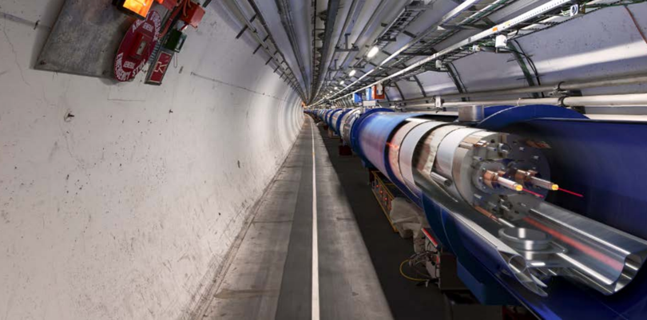
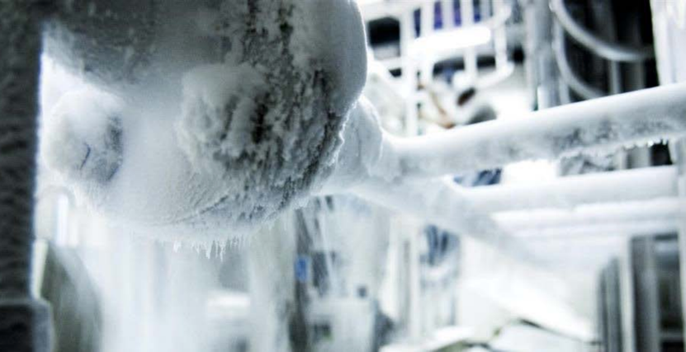
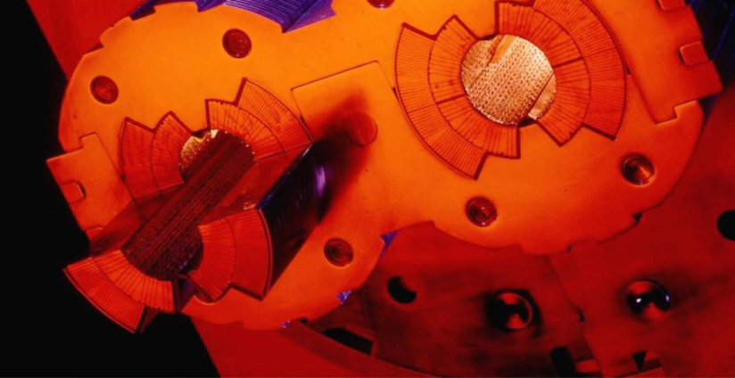
Why? …Big Data
LHC is entering the Big Data era
Accelerators infrastructure (control systems, monitoring )
9600 magnets for Beam Control
1232 superconducting dipoles for bending
Experiments (detectors & physics data)
330 PB of collisions data stored by December 2018
The computing infrastructure:
Large sets of metrics collected from system components (CPU and batch, disk and archive storage, network topology and flows, and application throughput)
LHC data represents a challenge since it is multi-structured, hybrid
Metadata
Databases Aggregation
Evolving Data model

Slide 17
From ridiculously difficult…
CMS simulation
...to almost impossible

Slide 18
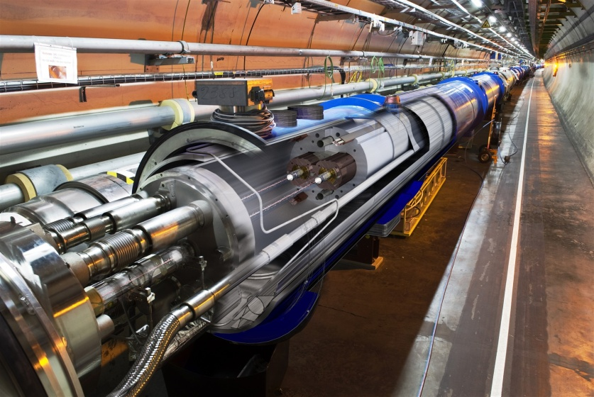
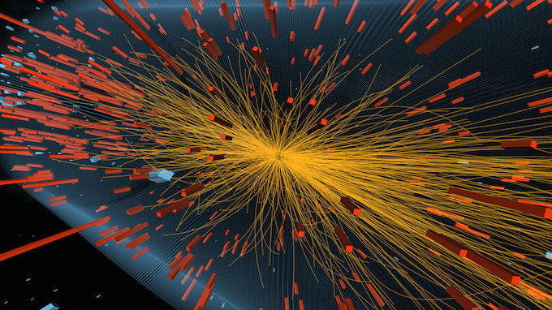
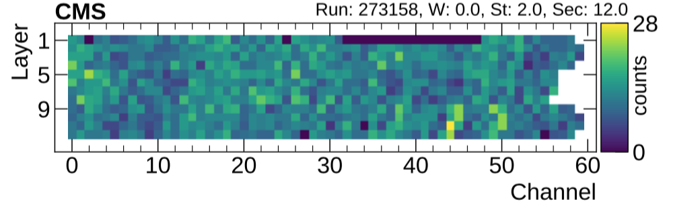
HPC and AI convergence in HEP
Deep Learning applications quickly multiply in High Energy Physics (HEP)
Extensive NN training will be a new workflow for large HEP experiments
Maximise performances
Fast turn-around for new trainings
Need dedicated hardware to be effective
HPC creates new AI models
Complicated network optimizations can have high computational cost
Train production-ready algorithms on HPC
Detector occupation map

Slide 19
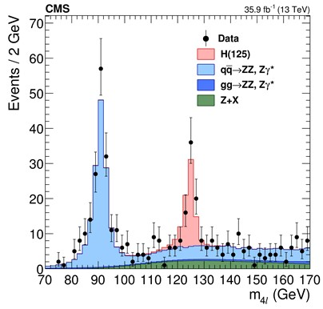

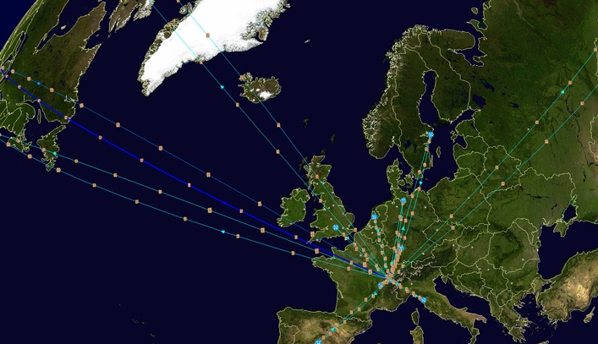
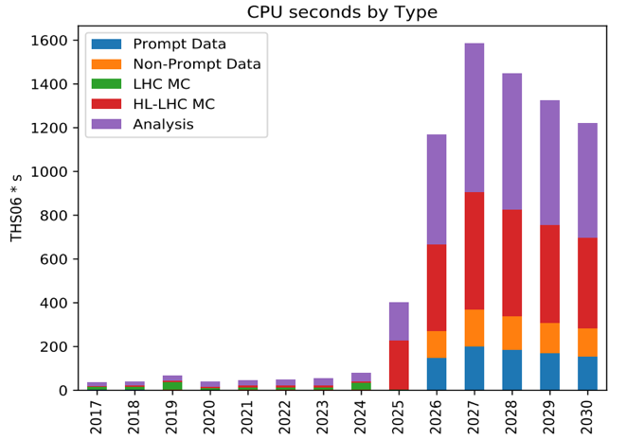
Monte Carlo Simulation
Essential for data analysis & detector design
Higgs boson
Understand how detector design affects measurements and physics
Correct for inefficiencies, inaccuracies, unknowns
Compare theory models to data
Complex physics and geometry modeling
>50% of Worldwide LHC Computing Grid (WLCG) power today
Increase by 100x by 2025!
CMS experiment
Flat Budget

Slide 20
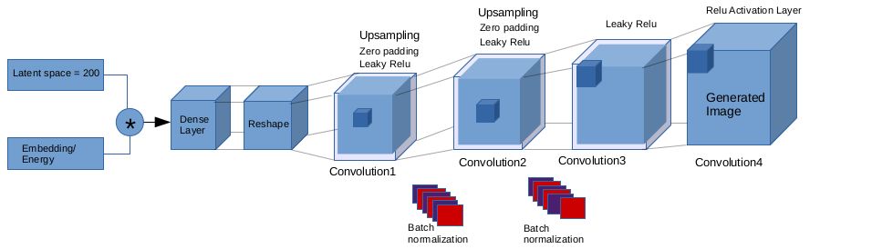
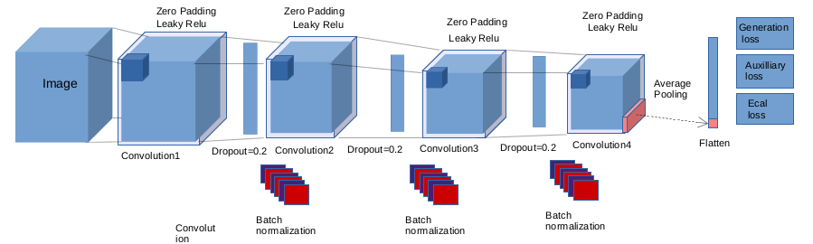
3D convolutional GAN
Generator
Discriminator
~1M parameters
Total model Size: 3.8MB

Slide 21
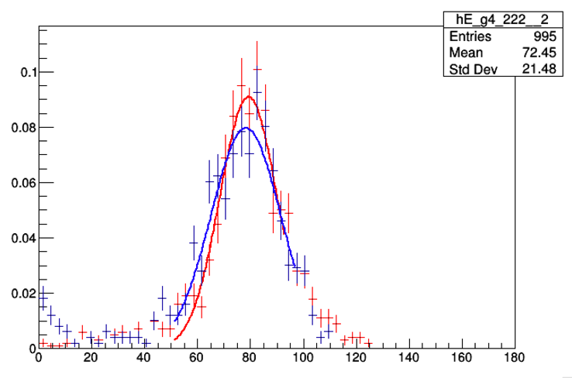
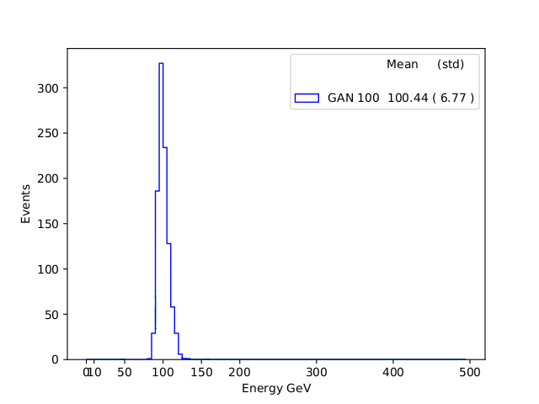
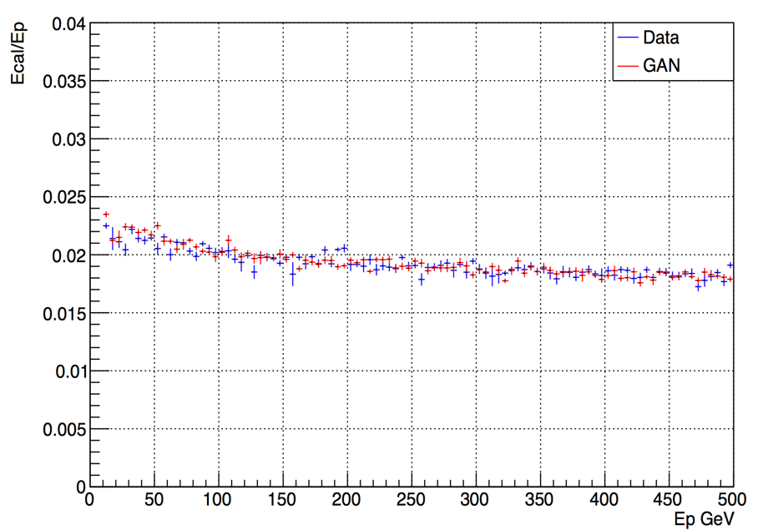
Physics results validation
Comparison to Monte Carlo data
Geant4
GAN generated
Single cell response
Primary particle energy
(100 GeV)
3D
Average shower section
GAN generated electron shower
Time to create an electron shower
Method | Machine | Time/Shower (msec)
MC Simulation (geant4) | Intel Xeon Platinum 8180 | 17000
3D GAN (batch size 128) | Intel Xeon Platinum 8180 | 7
Y moment (width)

Slide 22
Multi-Node Scaling Performance
Training Time/Epoch
94% scaling efficiency up to 128 nodes

Slide 23
Integration of AI and HPC: High Performance AI (HPAI) 18.06.2019 | Dr. David Brayford

Slide 24
Container
High Performance AI (HPAI) in a
Transition AI algorithms from the laptop to supercomputer
with minimal effort.
“It just works”

Slide 25
HPAI =
+
M&S
Analytics
Equation based on model
Computing driven
Numerically intensive
Creates simulations
Monte Carlo
Larger problems
Iterative methods
PDE
Finds patterns
Correlations in data
Logic driven
Creates inferences
Knowledge discovery
Graphs
Data-driven science
Predictions
CNN
RNN
Linear algebra
Matrix operations
Iterative methods
Compute intensive
Data transfer
Predictive
Probabilities
Stencil codes
Calculus
Pattern recognition
Graphs

Slide 26
Requirements for AI on HPC
HPAI @ LRZ
Compute intensive hardware
Optimized AI frameworks (TensorFlow, Caffe)
Optimized software (numerical libraries, Python)
HPC specific software (distributed computing, workload manager)
Method of deploying the AI software in a simple, straightforward and flexible way
Need to get to: “It just works”

Slide 27
Key Challenges
HPAI @ LRZ
Package Management
Frameworks have conflicting dependencies
→The frameworks & their dependencies need to be combined in a single module
Rapid update cycles
→Provide a mechanism for users to build there own frameworks
Dynamic Programming Environment
Python dependencies
→Each unique framework needs its own Python instance
Connecting to external servers
→Build frameworks on systems with internet access

Slide 28
Charliecloud containers in HPC
HPAI @ LRZ
Easy to install
Charliecloud was developed to be run on highly secure HPC systems
at US government labs
Charliecloud runs entirely under the User ID
Ability to run legacy design flows in containers
Low overhead and ~ 800 lines of code
LRZ deploys Charliecloud via Spack
Charliecloud is available in the module system at LRZ

Slide 29
Achieving High Performance AI on Secure HPC Systems
Deployment @ LRZ
Mechanism for deploying AI at LRZ:
Download the Intel optimized TensorFlow Docker Image (intelaipg Dockerhub)
Modify the Linux Docker image for HPC
Modify Python to enable distributed TensorFlow execution
Copy the training data and execution scripts to the modified Docker image
Convert to a Charliecloud UDSS and copy the file to the HPC system
Load the Charlicloud module
Execute on SuperMUC-NG via Slurm

Slide 30
Example Slurm script
Deployment @ LRZ
#!/bin/bash
#SBATCH --job-name="charliecloud_mpi_CERN_test_32"
#SBATCH --output="output_charliecloud_CERN_test_32.txt"
#SBATCH --error="error_charliecloud_CERN_test_32.txt"
#SBATCH --time=04:30:00
module load slurm_setup
module load mpi.intel/2019
module load devEnv/Intel/2019
module load charliecloud
mpirun -np 32 -ppn 4 ch-run -w /dss/dsshome1/08/di72giz/Docker/a408704d3f3d -- python /CERN/3Dgan-svalleco-sc18/keras/EcalEnergyTrain_hvd.py --model=EcalEnergyGan --datapath=/CERN/Data/*.h5 --channel_format='channels_first' --batchsize 16 --learningRate 0.001 --optimizer=Adam --latentsize 200 --intraop 11 --interop 1 --warmupepochs 0 --nbepochs 2

Slide 31
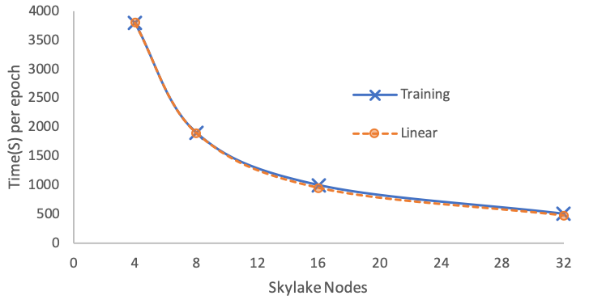
Distributed TensorFlow Results
Deployment @ LRZ
Example execution line in the Slurm script:
mpirun –np 32 –ppn 4 ch-run –w </path/to/my_image> --python <path/train.py>

Slide 32
Future
Collaboration
Together
Demonstrate vertically integrated solutions on showcase applications highlighting HPAI
BoF, presentations, workshops and tutorials
Create a community-focused HPC/AI benchmark suite
Container recipes, best practices
Release SC’19 Denver
HPC suitable Intel optimized TensorFlow Docker image
Verified recipes to enable the deployment of AI on HPC systems

